Slide 1
AI BASED POETRY GENERATION(SONNET)
ADA LOVELACE DAY HACKATHON
SUBMITTED BY:
K.J.BHASKER
A.RAGAVENTHRAN
N.SUBHIKSHA
R.SIVA SANDHIYA

Slide 2

CONCEPT:
Building a model with RNN concept ,to predict the words for the given starting string and generate a poem(14 lines) with approximate sentence meanings.
While some of the sentences are grammatical, most do not make sense. The model has not learned the meaning of words, but consider:
The model is character-based. When training started, the model did not know how to spell an English word, or that words were even a unit of text.
The output resembles a play—blocks of text with any input string.

Slide 3
FLOW DIAGRAM:
DOWNLOADING AND SPLITTING DATASET
START
IMPORTING LIB
READ AND PROCESS
DECLARING FUNCTIONS
MODEL
INPUT&
OUTPUT
API

Slide 4
IMPORTING LIB:
Install and import the following library file for this model
import tensorflow as tf
import numpy as np
import os
import time

Slide 5
DOWNLOADING AND SPLITTING THE DATASET
I used my google drive as my cloud storage and downloaded the dataset for my model ,I attached text document of training dataset with it in the name of ‘test.txt’
You can download it and copy the path name in the place of my path location
The dataset is to be aligned before feeding to the main program
Check the alignments and vocabularies in it by functions,and also check the size of datas

Slide 6
READING AND PROCESSING THE DATA:
Read the dataset and stored it in seperate variables and also for vocabularies
And use those variables for processing the datas
Vectorise the text for training
Make sure that each character is maped
After processing fed the dataset to training

Slide 7
DECLARING FUNCTION
This model is based on RNN(Recurrent Neural Network)
Declare the training and targets of the dataset
Check the lines sequential
Declare a function for text(poem) prediction
In this block the text is predicted
Use tensoflow application for make the recural network

Slide 8
TENSORFLOW APPLICATIONS
Tensorshape()::A tensor is a vector or matrix of n-dimensions that represents all types of data. All values in a tensor hold identical data type with a known (or partially known) shape. The shape of the data is the dimensionality of the matrix or array. A tensor can be originated from the input data or the result of a computation.
tensorslices()::The slice size is represented as a tensor shape, where size[i] is the number of elements of the 'i'th dimension of input_ that you want to slice. The starting location ( begin ) for the slice is represented as an offset in each dimension of input

Slide 9
tf.keras.sequential()::A Sequential model is appropriate for a plain stack of layers where each layer has exactly one input tensor and one output tensor. Schematically, the following Sequential model: # Define Sequential model with 3 layers. model = keras.
In this we use tf.keras.layers.GRU:whixh is used to build a recurrent neural networks based on the preibious word or phrase
For each character the model looks up the embedding, runs the GRU one timestep with the embedding as input, and applies the dense layer to generate logits predicting the log-likelihood of the next character:

Slide 10
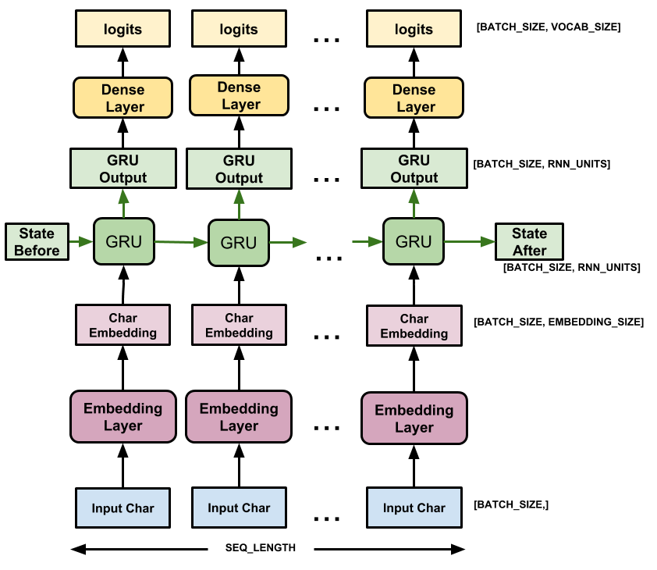

Slide 11
MODEL:
Now decode the text from array to words
This RNN will take decisions on the previous word
To keep this prediction step simple, use a batch size of 1.
Because of the way the RNN state is passed from timestep to timestep, the model only accepts a fixed batch size once built.
To run the model with a different batch_size, we need to rebuild the model and restore the weights from the checkpoint.

Slide 12
PREDICTION LOOP:
The following code block generates the text:
It Starts by choosing a start string, initializing the RNN state and setting the number of characters to generate.
Get the prediction distribution of the next character using the start string and the RNN state.
Then, use a categorical distribution to calculate the index of the predicted character. Use this predicted character as our next input to the model.
The RNN state returned by the model is fed back into the model so that it now has more context, instead than only one character. After predicting the next character, the modified RNN states are again fed back into the model, which is how it learns as it gets more context from the previously predicted characters.

Slide 13
INPUT AND OUTPUT
Now the model is ready to narrate a poem
Give the starting string as the input and get the recuurent poem as output in the same console window

Slide 14
API
Additionally API is interfaced to provoide user friendly environment
Which enable us to give input & get outputs
You just need to replace the API token of your bot to excecute this code in your telebot
You sholud provoide an hoist to run this in real time environment
Yoc can create a bot from BOTFTHER in the telegram from where you also get the API token
It enable us to remote access our model

Slide 15
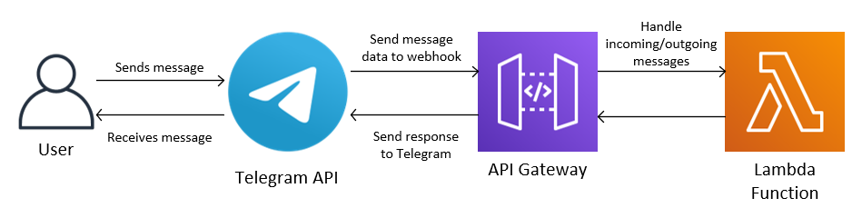
WORKING FLOW OF API:

Slide 16


